Slide 1


Objectives
In this session, you will learn to:
  Explore jQuery
  Add visual effects using jQuery

Slide 2
Demo: Creating a Game
Problem Statement:
  You work as a Web developer at GameMantra. The organization has a website that enables users to play online games. You have been assigned a task to create a game. The game should contain two characters, dave and monster. The dave character should try to catch as many monsters as it can in 30 seconds. After 30 seconds, the game should be over. In addition, if the dave character goes out of the game boundary, he should be dead and the game should be over. How will you create this game?
  Prerequisite: You need to use the Images folder that contains the images required to create the game. Ask your faculty to provide you the same. You need to save this folder at the D:\HTML\Game location.

Slide 3
Demo: Creating a Game (Contd.)
Solution:
  To create the required game, you need to perform the following tasks:
  1. Create the game.js file.
  2. Create the home.html file.
  3. Run the game.

Slide 4
Exploring jQuery
jQuery:
  Is an open source and cross-browser library of JavaScript codes that was created to
  make the JavaScript programming simpler.
  Can be used to enhance the look and feel of a Web page.
  Bridges the gap between extensive coding and Web designing.

Slide 5
Manipulating HTML Elements by Using jQuery
  jQuery can be referred by downloading the light-weight jQuery JavaScript library.
  Once the library is downloaded, it can be referred to in a Web page using the
  following syntax:
    <SCRIPT type="text/javascript" src="<path>/jquery-1.8.3.js">
    </SCRIPT>

Slide 6
Manipulating HTML Elements by Using jQuery (Contd.)
  jQuery provides the document.ready() function for preventing failure of actions that should be performed on an HTML element.
  The following syntax is used to specify the document.ready() function:
    <SCRIPT type="text/javascript">
    $(document).ready(function(){
    // jquery code...
    });
    </SCRIPT>

Slide 7
Manipulating HTML Elements by Using jQuery (Contd.)
  jQuery selectors:
  Are used to select and manipulate the HTML elements using the following ways:
Element name
Attribute name
CSS selectors

Slide 8
Manipulating HTML Elements by Using jQuery (Contd.)
  jQuery provides predefined functions to perform modifications on the content of
  HTML elements.
  Some of the jQuery predefined functions are:
html()
remove()
after()
val()
empty()
append()
before()
attr()
text()
prepend()

Slide 9
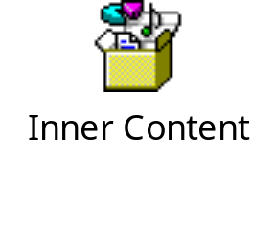
Manipulating HTML Elements by Using jQuery (Contd.)
  The following embedded Notepad file contains the code for modifying the inner
  content of HTML elements:

Slide 10
Handling jQuery Events
  In jQuery, events are handled by using the event methods.
  An event method is used to detect an event and trigger a function when that event occurs.
  Some of the event methods are:
  $(document).load(function)
  $(selector).click(function)
  $(selector).dblclick(function)
  $(selector).mouseenter(function)
  $(selector).mouseleave(function)
  $(selector).keydown(function)
  $(selector).submit(function)
  $(selector).focus(function)
  $(selector).blur(function)
  $(selector).resize(function)
  $(selector).unload(function)
  $(selector).mousedown(function)
  $(selector).mouseup(function)

Slide 11
Just a Minute
Which one of the following functions removes all the text and nested elements of
the selected HTML element?
  remove()
  empty()
  prepend()
  append()

Slide 12
Just a Minute (Contd.)
Solution:
  empty()

Slide 13
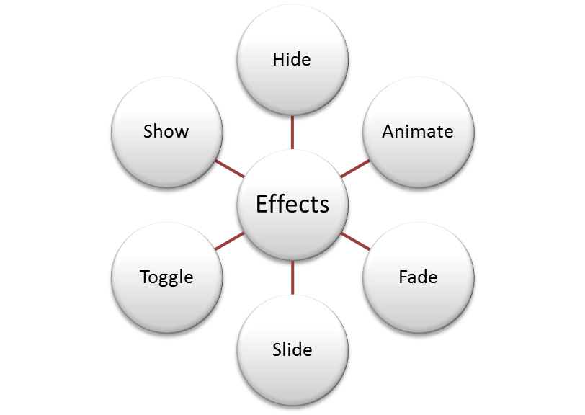
Adding Visual Effects Using jQuery
  Visual effects:
  Help to enrich the browsing experience of a user.
  Are used to add visual appeal to a Web page.
  Can be added using the following predefined jQuery effects:

Slide 14
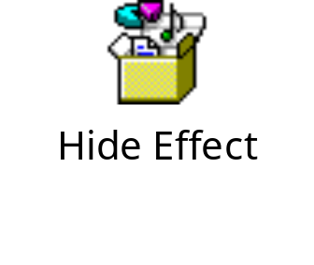
Implementing Hide Effect
  The hide() function:
  Is used to make an element disappear when an event occurs.
  Has the following syntax:
  $(selector).hide(speed)
  The following embedded Notepad file contains the code to implement the hide
  effect:

Slide 15

Implementing Show Effect
  The show() function:
  Is used to make a hidden element visible when an event occurs.
  Has the following syntax:
  $(selector).show(speed)
  The following embedded Notepad file contains the code to implement the show effect:

Slide 16
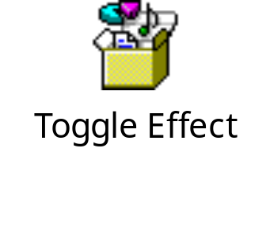
Implementing Toggle Effect
The toggle() function:
  Can be used to switch between the show and hide effects of an element.
  Has the following syntax:
$(selector).toggle(speed)
  The following embedded Notepad file contains the code to implement the toggle
  effect:

Slide 17
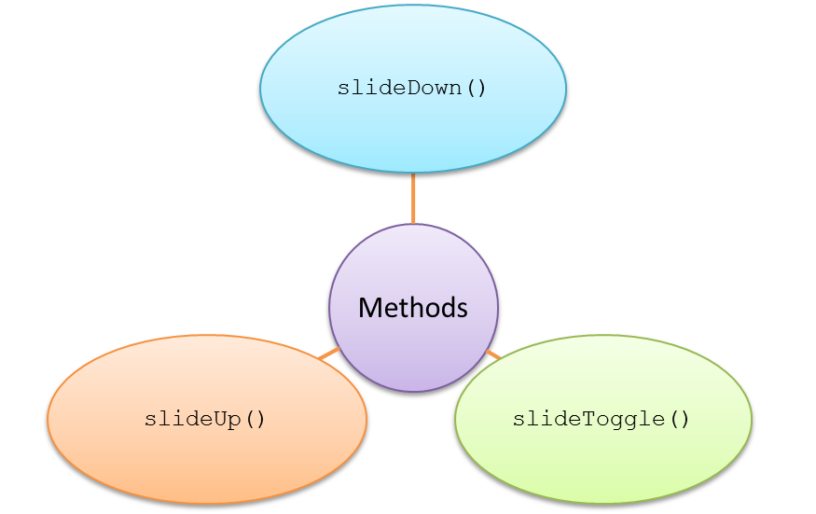
Implementing Slide Effect
  The slide effect:
  Can be used to produce a sliding effect on the selected elements.
  Can be implemented using the following functions:

Slide 18

Implementing Slide Effect (Contd.)
  The following embedded Notepad file contains the code to implement the slide
  effect:

Slide 19
Summary
In this session, you learned that:
  jQuery is an open source and cross-browser library of JavaScript codes that was created to make the JavaScript programming simpler.
  jQuery can be referred by downloading the light-weight jQuery JavaScript library.
  jQuery provides the document.ready() function for preventing failure of actions that should be performed on an HTML element.
  jQuery selectors are used to select and manipulate the HTML elements.
  An event method is used to detect an event and trigger a function when that event occurs.
  Visual effects help to enrich the browsing experience of a user.
  The hide() function is used to make an element disappear when an event occurs.
  The show() function is used to make a hidden element visible when an event occurs.
  The toggle() function can be used to switch between the show and hide effects of an element.
  The slide effect can be used to produce a sliding effect on the selected elements.

